Slide 1
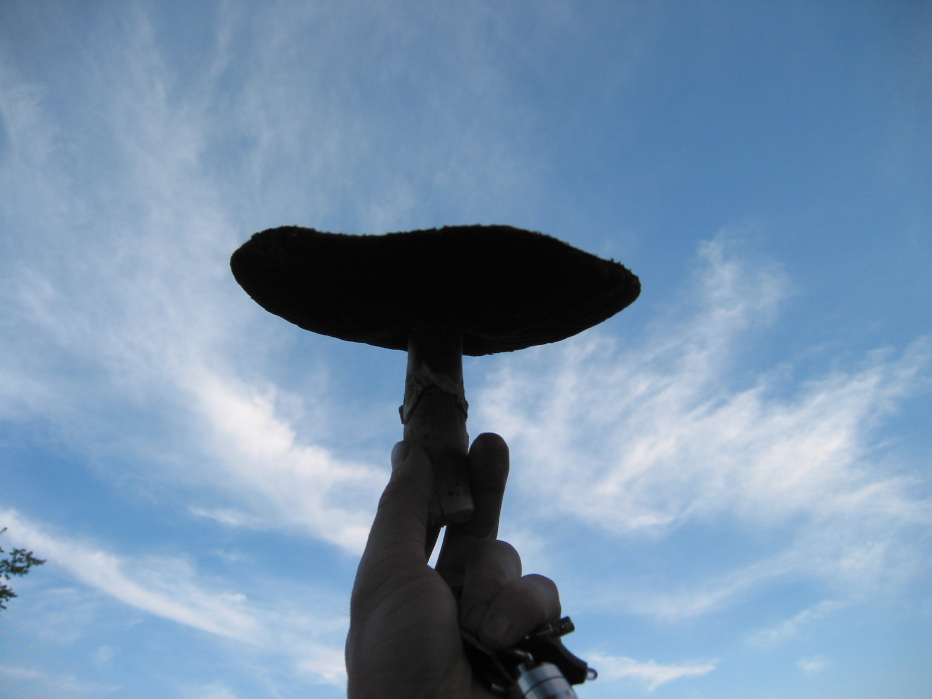
Mycofacilitation: Increasing Ecosystem Health With Fungi
By
David Demarest
Green Mountain Mycosystems, LLC
www.vermontmushrooms.com

Slide 2
Who?
~ 1.5 million species of fungi
~140,000 species of mushrooms
What?
“The natural & true ecosystem engineers”
(Lawton and Jones 1995, as cited in Singh 2006)
When?
Fossils of spores/hyphae ~460 million years ago
(Vellinga, 2002)
Where?
Ubiquitous
Why?
Life as we know it would not be possible without them...

Slide 3
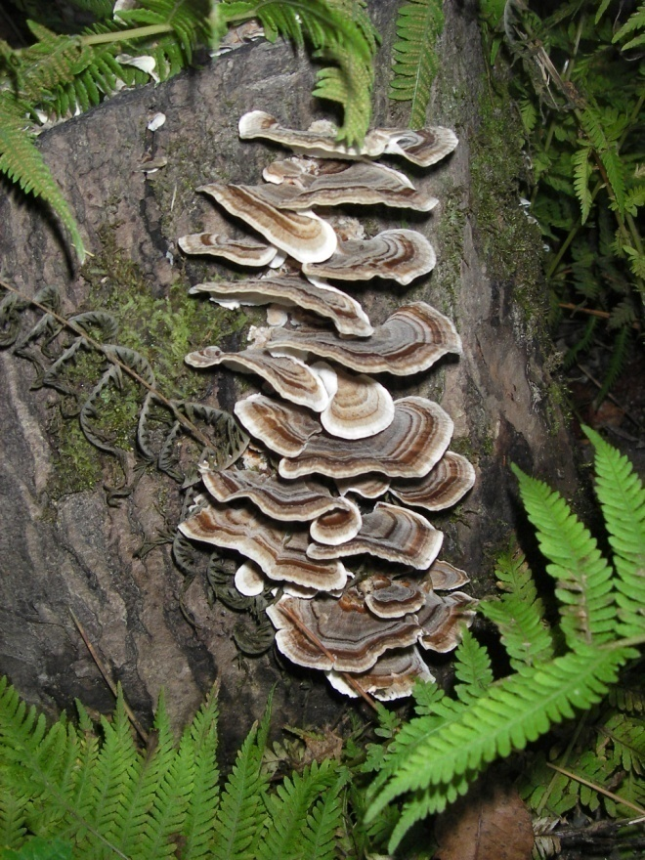
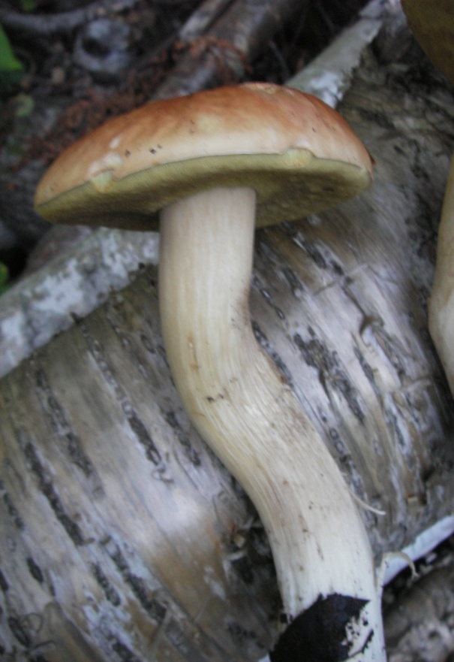
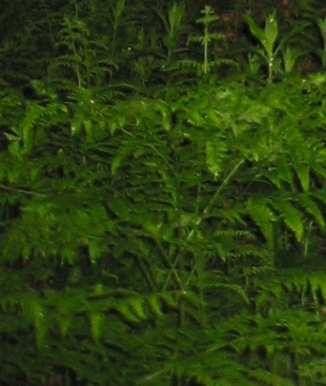
Mycoremediation Phytoremediation
Mycorrhizomal Remediation

Slide 4
Mycoremediation: Separating Fact from Fiction
Fungi can make arsenic disappear.

Slide 5
Fact, sort of...
Fungi can transfer methyl groups as carbonium ions (CH3+) by S-adenosyl-methionnine (Tamaki & Frankenberger, 1992, Gadd 1993b as cited in Gadd 2001)
The biomethylation of metalloids frequently results in their volatilization (Gadd 1993b, as cited by Gadd 2001)
But obviously it’s still arsenic, and there is no legitimate reason to ever emit arsenic into the atmosphere!

Slide 6
Mycoremediation: Separating Fact from Fiction
Mycoremediation is simpler and cheaper than conventional remediation options.

Slide 7
Fiction!
In fact, mycoremediation can be a substantially less expensive remediation option in some situations.
HOWEVER
In many situations this is not the case, especially when the project timeline is considered and the fact that the project is dependent on substantially more variables for success.
All that should be claimed is that mycoremediation has the potential to be cost competitive with existing remediation technologies.

Slide 8
Mycoremediation: Separating Fact from Fiction
Turkey Tail mushrooms have been proven to break down dieldren so I can order some mushroom spawn to mix into my dieldren contaminated soils and end up with clean soil.

Slide 9
Fiction!
In fact, Turkey Tail Mushrooms (Trametes versicolor) have demonstrated the ability to degrade dieldrin in the lab (Morgan et al. 1991 as cited in Gadd 2001)
HOWEVER, successful degradation of a compound in the lab does not directly correlate to success under field conditions!

Slide 10
Mycoremediation: Separating Fact from Fiction
Mycoremediation can save the world.

Slide 11
Fiction!
In fact, mycoremediation can play a pivotal role in breaking down numerous toxic substances and mycofacilitation can help transform a degraded location into a thriving ecosystem with increased diversity and resilience to environmental stresses.
Saving the world will require a complete paradigm shift.
We, as a society, need to adopt a Traditional Chinese Medicine approach to our vital ecosystems. Preventing the problems in the first place MUST become everyone`s priority.

Slide 12
Potential for Mycoremediation
Petroleum hydrocarbons
Industrial wastewaters
Polychlorinated biphenyls and dioxins
Pesticides, especially persistent pesticides
Phenols, chlorophenols, and pentachlorphenol
Polycyclic aromatic hyrdocarbons (PAHs)
Heavy metal biosorption
Dyes, pulp and paper effluents, brewery waste, etc

Slide 13
Mycoremediation Strategies
Depending on the contaminant compound it may be:
Used as a carbon source
Enzymatically attacked. but not used as a carbon source (cometabolism)
Taken up and concentrated (bioaccumulation)
but not metabolized
(Bennett, 2002)

Slide 14
Petroleum Hydrocarbon Remediation
Many fungi are known to be able to utilize hydrocarbons as a carbon source (food), although oxidation by enzymes can also be a significant remediation option.
Fungi can assist in remediation of crude oil and diesel fuel spills, MTBE in groundwater, and more in many ways...
The phytoremediation of arabian medium crude oil contaminated soils using Lolium multiflorum (Italian ryegrass) was significantly improved by inoculation with Glomus intraradices (arbuscular mycorrhizal fungus), Sphingomonas paucimobilis (petroleum degrading bacteria) and Cunninghamella echinulata (filamentous fungus).

Slide 15
Petroleum Hydrocarbon Mycoremediation
Tall fescue and meadow fescue (Festuca arundinacea and F. pratensis) infected with EM (Neotyphodium coenophialum and Neotyphodium uncinatum) had improved ability to assist in the breakdown of C10-C25 and TPH than uninfected plants (Soleimani et al. 2010)
Practical side note: The addition of compost has proven effective at enhancing degradation of diesel oil and four-ring PAHs (Gandolfi et al. 2010)
NOTE: Significant impact of type of HC (aliphatic hydrocarbons vs aromatics)

Slide 16
Peak Oil, Global Climate Change & Oil Spills
Convert sustainable sources of energy into useful forms:
Gliocladium roseum growing in Eucryphia cordifolia of Northern Patagonia
actually converts cellulose to diesel!!!
Arbuscular mycorrhizal fungi are an important tool we can use in carbon
sequestration.
While changes in our climate and dwindling supplies of oil are becoming
increasingly obvious few things so dramatically demonstrate the impact of our
society’s oil addiction as the devastation caused by OIL SPILLS...

Slide 17
Oil Spill Remediation Steps
1) Prevention, prevention, prevention!
2) Rapid correct response in the event of an oil spill!
effective recovery and containment systems
3) Determination of best oil spill treatment options
in situ vs ex situ
identification of key variables to remediation success
4) Realistic analysis of remediation project results and specific variables involved for future use and improvement of existing methods

Slide 18
TM Demarest Process Integrated Oil Spill Remediation and Energy Recovery System
Containment and Recovery of Oil Spill
Rapid Deployment of Methane Digesters in Proximity to Oil Spill
Injection of liquid effluent into stranded oil reserves and/or low performing wells

Slide 19
TM Demarest Process Integrated Oil Spill Remediation and Energy Recovery System
Containment and Recovery of oil spill using currently available and new technologies.
The Demarest process can begin with oil recovered using a wide variety of methods. Even oil recovered from a spill using oil-sorbant materials such as peat moss, hemp, textile fabric waste, human hair, coir, and other natural or synthetic sorbant materials can be converted into useable energy!
Rapid onsite (or near site) deployment of methane digesters to break down oil.
Mixing biological inoculums and local organic waste materials with the recovered hydrocarbons enables degradation of petroleum hydrocarbons into usable methane for use or sale. Emphasis on achieving appropriate digester biology for optimal methane yield and development of appropriate inoculums is essential for success.
Anaerobic transport and injection of liquid methane digester effluent into stranded oil reserves and/or low performing wells.
This cost-effective biostimulation and bioaugmentation approach to recovery of stranded energy can convert oil reserves into easily recoverable methane and/or facilitate well pressurization.
This less environmentally destructive source of inexpensive energy can be used to help transition away from fossil fuel dependence and reduce the desperate implementation of more and more environmentally destructive energy extraction methods.

Slide 20
TM Demarest Process (continued) Integrated Oil Spill Remediation and Energy Recovery System
Gieg et al. 2008 calculated the amount of methane that could theoretically be recovered from known domestic petroleum systems (375 billion barrels)
1-5 TRILLION CUBIC FEET PER YEAR!!!
(citation from Gray et al, 2010)
But obviously when it’s gone, it’s gone...
The Demarest Process merely hopes to help provide a less environmentally destructive source of affordable energy to help in a transition away from fossil fuels while reducing the impacts of oil spills and building methane digesters that can later be used with natural organic waste streams as a component of a sustainable energy system.

Slide 21
Chlorinated Compound Mycoremediation
Ligninolytic fungi such as Phanerochaete chrysosporium have demonstrated ability to degrade chlorinated compounds such as DDT.
Lestan et al. published methods for inoculation of P. chrysosporium into contaminated soils in 1996. However it is worth noting that as far back as 1968 research had already demonstrated the ability of certain fungi to degrade DDT (known species included Mucor alternans, Fusarium oxysporum, and Trichoderma viride).
P. Chrysosporium, P. Ostreatus, Phellinus weirii and Polyporus versicolor were able to mineralize 5.3-13.5% of added DDT, dicofol, and methoxychlor over 30 days under ligninolytic growth conditions (Kennedy et al. 1990 as cited in Pointing et al. 2001)
NOTE: Biodegradation of DDT can result in toxic and persistent metabolites (Pointing et al. 2001) Degradation of metabolites into nontoxic substances must be factored into the remediation project!

Slide 22
Industrial Wastewater Mycoremediation
Example: Dairy Bioreactor
Why needed?
COD of whey 50000-80000 mg/l Lactic acid bacteria will significantly lower effluent pH and many other organisms cannot effectively utilize it
Airlift (repeated fed batch of whey/dairy effluent) using mixed yeast cultures can accomplish a 96% reduction in COD within 60 hours (Christiana-Urbina et al. 2000 as cited in Singh 2006)

Slide 23
Polychlorinated Biphenyls Mycoremediation
P. Chrysosporium, in addition to Pleurotus ostreatus, Coriolopsis polysona, Trametes versicolor, Bjerkandera adusta, and Lentinula edodes have demonstrated the ability to degrade many PCBs.
Close to 90% degradation of PCD-contaminated soil has been demonstrated using P. chrysosporium grown on sugarcane bagasse pith (Fernandez-Sanchez et al. 1999)
Grifola frondosa accumulates dichloromethoxyphenol during degradation of PCB 48 in low-nitrogen medium (Seto et al 1999)

Slide 24
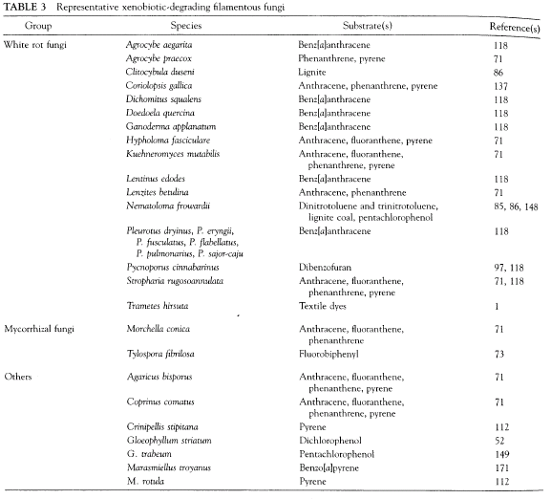
Xenobiotic Degrading Filamentous Fungi (copied from Bennett et. al. 2002)

Slide 25
Polycyclic Aromatic Hydrocarbons Mycoremediation
PAHs (polycyclic aromatic hydrocarbons) are often degraded more rapidly by bacteria; however, in certain circumstances (such as PAHs with more than 4 aromatic rings) fungi play a pivotal role in successful degradation of PAHs.
Remember: The addition of compost has proven effective at enhancing degradation of diesel oil and four-ring PAHs (Gandolfi et al. 2010)
Many fungi have demonstrated ability to degrade two to six ring aromatics include Zygomycete Cunninghamella elegans, Ascomycetes Aspergillus niger and Penicillium sp. and the white-rot Basidiomycetes Phanerochaete chrysosporium, Trametes versicolor, Pluerotus ostreatus, and Bjerkandera sp. (Singh, 2006)
Generally PAH metabolites are less toxic than parent compounds BUT some quinones or hydrozy derivatives are more toxic and mutagenic.

Slide 26
Heavy Metals and Radionuclitides
Hyperaccumulation and Biosorption are really your only practical options...
Marcellus Shale Hydofracking: JUST SAY NO! Catskillmountainkeeper.org
Filamentous fungi can hyperaccululate metals and radionuclitides in mycelium or fruitbody.
Mycorrhizal fungi can be influential in either avoidance or sequestration of pollutant.

Slide 27
Fungi Breaking Down Used Tires, Concrete, & Plastic!
Bredberg et al. demonstrated Resinicium bicolor to be effective at detoxifying tire rubber prior to devulcanization (2002)
Species of Fusarium contribute to loss of calcium and weight in concrete (Gu et al., 1998) and loss of concrete bonding strength has been attributed to acids produced by Aspergilis niger and Mycelia sterilia (Perfettini et al., 1991)
Gusse et al. (2006) demonstrated the ability of Phanerochaete chrysosporium to degrade phenolic resin polymers (a common industrial polymer used in plywood, particle board and Formica counter tops and many other products)

Slide 28
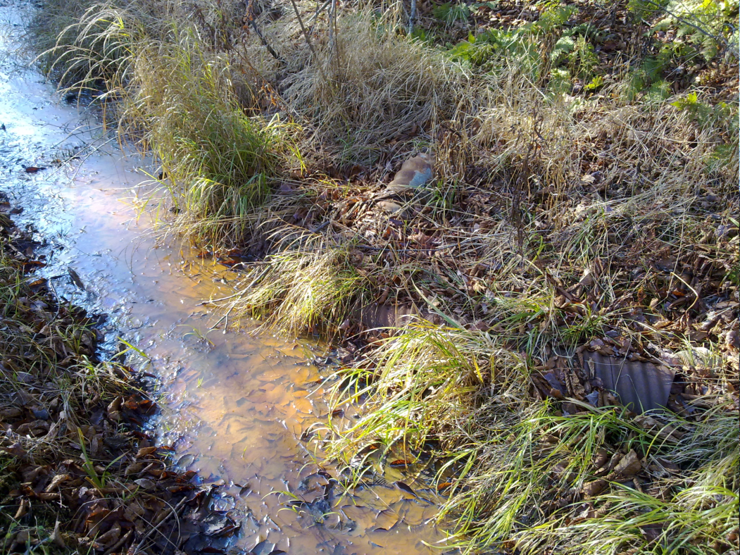
Contaminated Water
Benefits of using fungi
Many pollutants can be rapidly broken down by fungi
Biosorption capabilities for heavy metals
Concerns to consider if using fungi
Volume of water creating saturated conditions
without effective aeration
High loading rates of:
biological contaminants
or
nitrogen

Slide 29
Some Common Methods
Flow through outdoor beds composed of wood chips, etc
Stirred tank bioreactors
Membrane bioreactors (MBRs)
“Successful use depends on a comprehensive knowledge of fungal physiology, biochemistry, enzymology, ecology, genetics, molecular biology, engineering, and several related disciplines. The field conditions and factors that induce fungal biodegradation are taken into consideration before the final design.” (Singh, 2006)

Slide 30
AMRET
Aerobic Microbial Respiration and Evapo-Transpiration discussed in The Composting Toilet Book by Del Porto and Steinfeld
Outdoor ET rates ~ 0.05 to 0.2 gpd/sf
Greenhouse ET rates ~ 0.5 to 3.0 gpd/sf
(Del Porto and Steinfeld, 1999)
or a well designed constructed wetland is generally a more effective long-term option for high nutrient waste steams.
Where fungi really excel is at dealing with complex compounds plants can’t break down...

Slide 31
Contaminated Soils
Benefits of using fungi
Many pollutants can be rapidly broken down by fungi
Soil mycoremediation strategies build healthy soil
Concerns if using fungi
Heavy metal and radionuclide contamination
Ability of desired species to colonize substrate, and survive long enough, to achieve treatment goals

Slide 32
Soil Mycoremediation Methods
Ex-Situ verse In-Situ
Project must:
Provide biological needs of fungi (adequate air, water, nutrients, pH, etc)
Prevent effective biological competitor
Be monitored until completion
EXCEPTION to first to points: if previously myceliated substrate
contains required enzymes for breakdown of toxic substances simple
bulk addition of substrate can be an effective option...

Slide 33
Mycorrhizomal Remediation
Benefits
Enhances breakdown of organic contaminants
May enhance phytoextraction of heavy metals
Intended mycorrhizal communities can sustain themselves under field conditions longer than saprophytic fungi
Downsides
Time-frame until completion
Potential difficulties establishing optimal mycorrhizal species
Mixed pollutants may require successional strategy

Slide 34
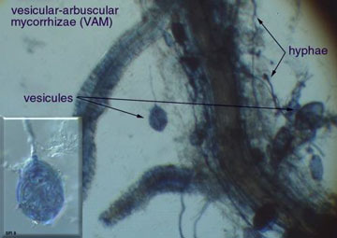
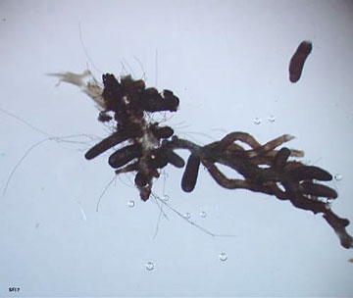
7 Associations Classified Arbuscular, Ectomycorrhiza, Ectendomycorrhiza, Ericoid, Arbutoid, Orchid, Monotrophic
Ectomycorrhiza (ECM)
No host cell penetration
Relatively host specific
Extremophiles
Degrade a range of POP
Vesicular-arbuscular mycorrhiza (VAM)
Host cell penetrated by hyphal network
Occurs in about 2/3 of plants
Endomycorrhizas help considerably
with phosphorus uptake
Photos courtesy of soilfoodweb.com

Slide 35
Mycorrhizomal Remediation Potential
PCBs, atrazine, and many more POPs can be degraded by mycorrhizal fungi
(Donnelly and Fletcher, 1994 as cited in Chaudhry, 2005)
(Anderson and Coats, 1995 as cited in Chaudhry, 2005)
A mix of grasses inoculated with mycorrhizal fungi can hyperaccumulate arsenic
Festuca rubra, Festuca eliator, Agropyron repens, and Trifolium repens inoculated Glomus intraradices had a maximum As shoot concentration of 1,713 μg/g growing on soils with an arsenic content of 50 μg/g under optimal conditions (Giasson et. al. 2006)

Slide 36
General Rule of Thumb (like all rules of thumb there are always exceptions!)
VAM
Very good for Accumulation of Metals
ECM / ERM
Excellent Chemical Metabolization / Enzymes

Slide 37
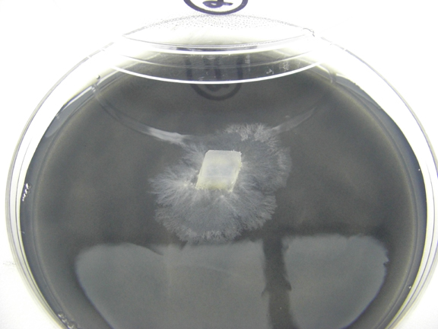
Substantial research on mycoremediation is done...
The future promises the development of successful field applications for this technology...
Photo of fungi isolated from a piece of charcoal I found in tank of water

Slide 38
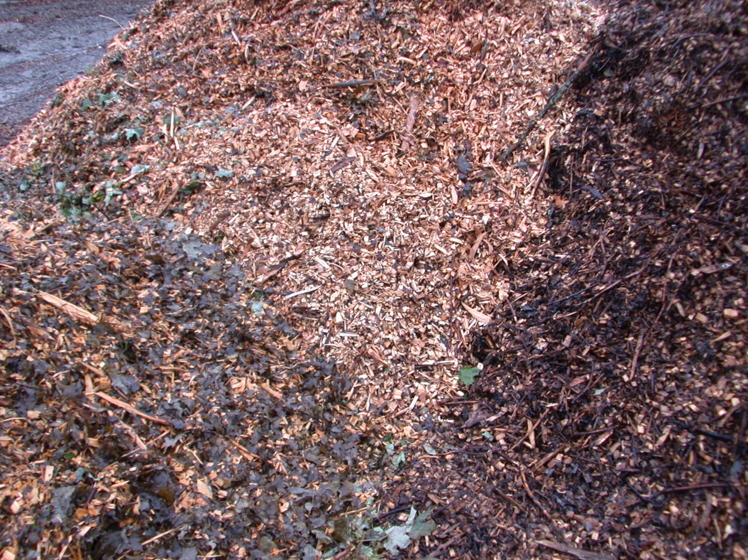
Ramial Woodchips
How to Make and Use Ramial Woodchips
Chipping the TOPS of hardwoods (preferably maple/oak/beech, avoid softwoods)
Use as you would
mulch around your
plants and any other
areas you wish to build
healthy vibrant soil

Slide 39
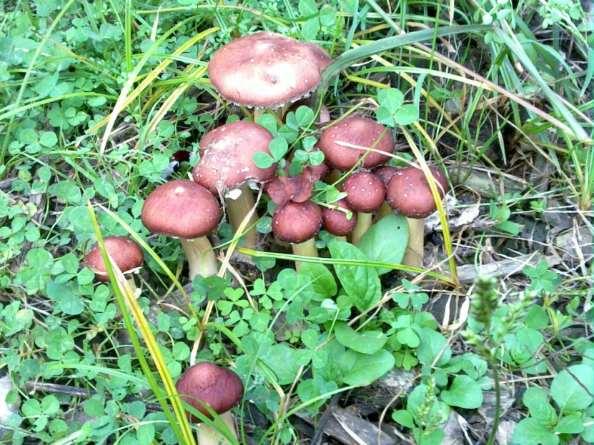
King Stropharia
Soft maple, box elder, poplar and other “softer``
hardwoods ideal, but otherwise standard RWC rules
Main difference between simple RWC and
growing King Stropharia is that you add 10 lb of
sawdust spawn per 100 sq. ft of beds (3-4” deep)
Oh, and that they taste great...
NOTE: Avoid alcohol when
consuming K.S.

Slide 40
Soil Testing Services
University of Vermont Soil Testing Lab
http://www.uvm.edu/pss/ag_testing/?Page=soils.html
Alternative Soil Testing Lab Resource List
http://attra.ncat.org/attra-pub/soil-lab.html
GREAT Laboratory to Better Understand What is Living of Your Soil
http://www.soilfoodweb.com
Woods End Microbiological Testing www.woodsend.org
Endyne, Inc – For a wide range of analytical tests www.endynelabs.com/

Slide 41
Mycofacilitation Resources
Green Mountain Mycosystems website
www.vermontmushrooms.com
A Good Article about “Fungal Curve” by Michael Phillips
www.groworganicapples.com/organic-orcharding-articles/orchard-ecosystem.php
A Quebec Group with Information on Ramial Woodchips
www.hydrogeochem.qc.ca/pages/rcw.html
A searchable database of literature, includes mycoremediation
www.pubmed.com (hint: search for specific keywords)

